Slide 1
[Simulation Lab] Weighted Average
Earlier in the course, we learned how to take many measurements, find a mean, and that the uncertainty in the mean is given by the standard deviation of the mean
This assumes the information provided by each individual measurement are the same. Sometimes this is not the case! For example if their uncertainties are different.
We can instead use a weighted average. We multiply each measurement times a weight, then divide by the total weight rather than the total number.

Slide 2
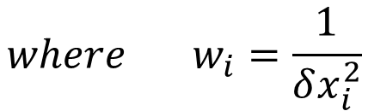
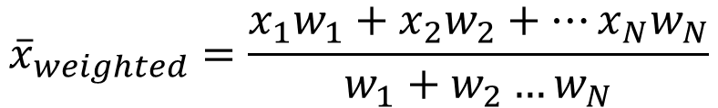
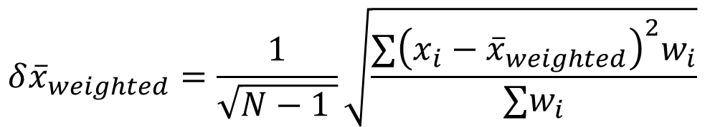
[Simulation Lab] Weighted Average
For example we can weight each measurement so that those with small uncertainty “count more” and those with larger “count less”:
The associated uncertainty of the weighted average is:
Notice these formulas simplify to the regular old mean and standard deviation of the mean if all the uncertainties are the same!
$${\overline{x}}_{weighted}=\frac{x_{1}w_{1}+x_{2}w_{2}+…x_{N}w_{N}}{w_{1}+w_{2}…w_{N}}$$
$${where w}_{i}=\frac{1}{δx_{i}^{2}}$$
$${δ\overline{x}}_{weighted}=\frac{1}{\sqrt{N−1 }}\sqrt{\frac{∑{\left(x_{i}−{\overline{x}}_{weighted}\right)}^{2}w_{i}}{∑w_{i}}}$$

Slide 3
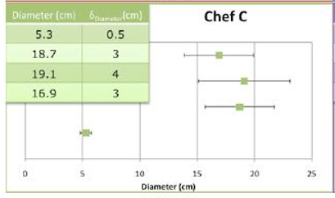
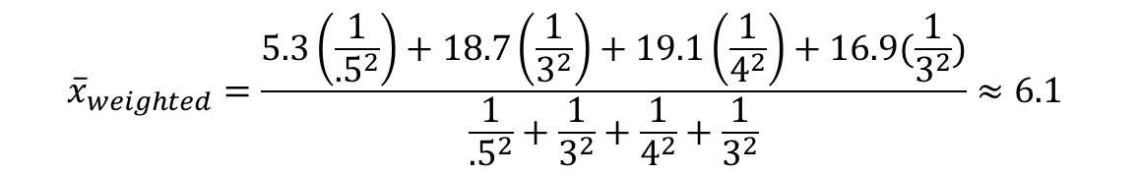
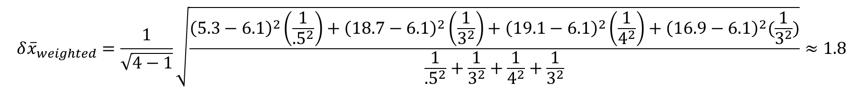
[Simulation Lab] Weighted Average
Example: Chef C
Notice this is closest to 5.3, because the uncertainty is very small!
So the final result is: 6.1+/-1.8 cm
(If we’d used a regular average we’d have gotten: 15+/-3 cm)
$${\overline{x}}_{weighted}=\frac{5.3\left(\frac{1}{{.5}^{2}}\right)+18.7\left(\frac{1}{3^{2}}\right)+19.1\left(\frac{1}{4^{2}}\right)+16.9(\frac{1}{3^{2}})}{\frac{1}{{.5}^{2}}+\frac{1}{3^{2}}+\frac{1}{4^{2}}+\frac{1}{3^{2}}}≈6.1$$
$${δ\overline{x}}_{weighted}=\frac{1}{\sqrt{4−1}}\sqrt{\frac{{\left(5.3−6.1\right)}^{2}\left(\frac{1}{{.5}^{2}}\right)+{\left(18.7−6.1\right)}^{2}\left(\frac{1}{3^{2}}\right)+{\left(19.1−6.1\right)}^{2}\left(\frac{1}{4^{2}}\right)+{\left(16.9−6.1\right)}^{2}(\frac{1}{3^{2}})}{\frac{1}{{.5}^{2}}+\frac{1}{3^{2}}+\frac{1}{4^{2}}+\frac{1}{3^{2}}}}≈1.8$$

